Slide 1
Designing Network Design Spaces
Ilija Radosavovic, Raj Prateek Kosaraju, Ross Girshick, Kaiming He, Piotr Dollar
Facebook AI Research (FAIR)
Dongze Lian
2020/4/10

Slide 2
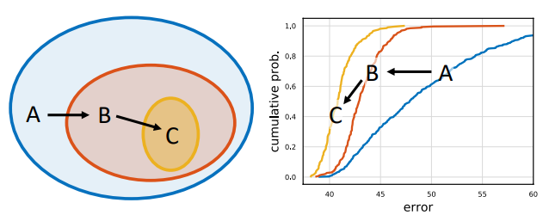
Motivation
Why
NAS for instance does not enable discovery of network design principles
Do not allow us to generalize to new settings
How to design
design design spaces that parametrize
populations of networks, which means
how to find a good design space.

Slide 3
Difference from architecture search
NAS: Goal is to find the single best model from the space.
This paper: such design principles can provide insights into network design and are more likely to generalize to new settings (unlike a single model tuned for a specific scenario).

Slide 4
Tools for Design Space Design
What design space is good? (very important)
Solution: Statistic method (similar to Monte Carlo method)
We sample and train n models from a design space. low-compute, low-epoch, 400 million flop (400MF), 10 epochs
training 100 models at 400MF for 10 epochs is roughly equivalent in flops to training a single ResNet-50 [8] model at 4GF for 100 epochs.

Slide 5

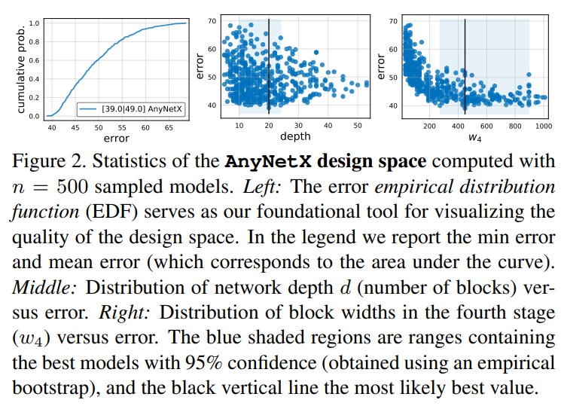
Tools for Design Space Design
Tools: error empirical distribution function (EDF).
AnyNetX
(2) Empirical bootstrap:
https://blog.csdn.net/arlionn/article/details/100777004

Slide 6
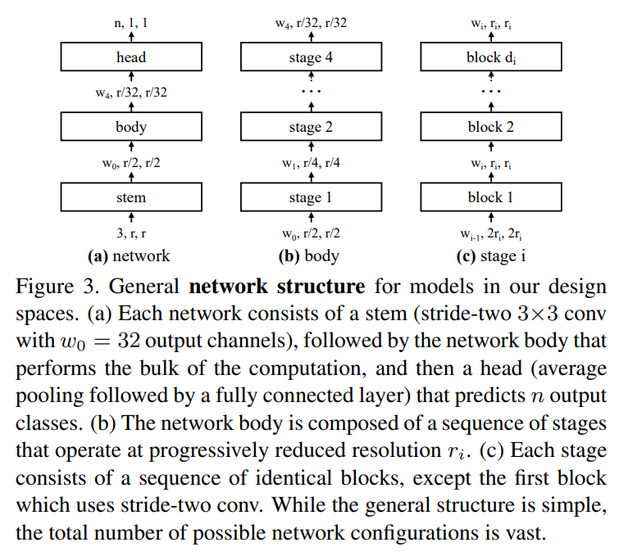
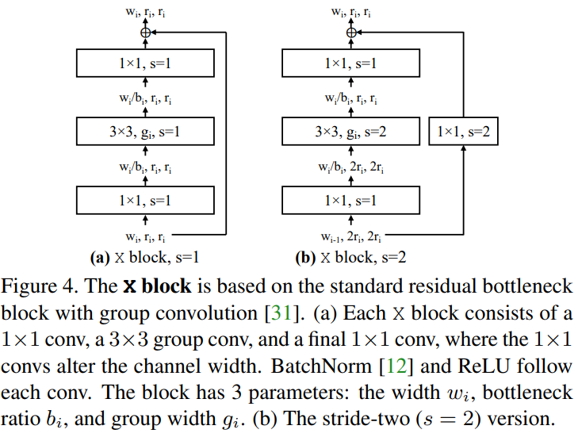
The AnyNet Design Space

Slide 7
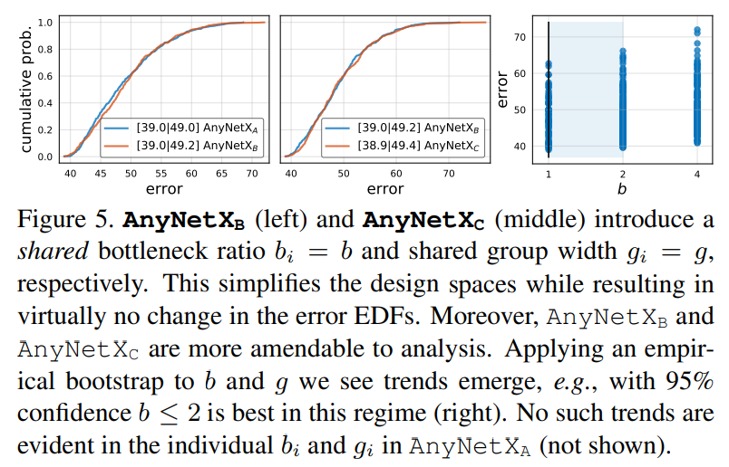





The AnyNet Design Space
Freedom: 16 degree (4 stages and 4 parameters)
Parameters:
The number of blocks
block width
bottleneck ratio
group width
Sampling :
Search space:

Slide 8
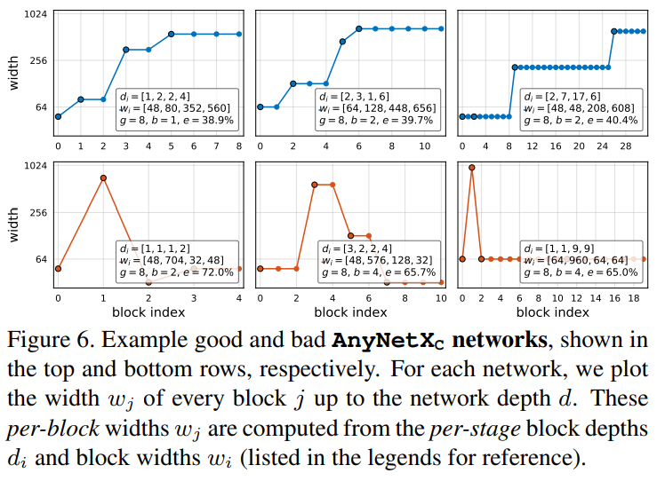
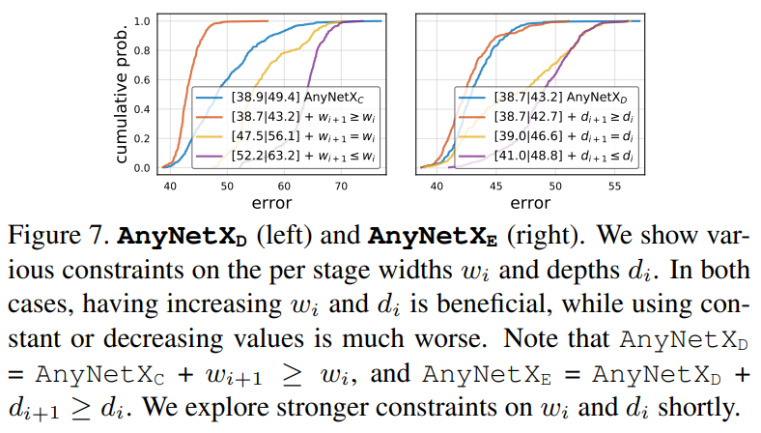
The AnyNet Design Space

Slide 9

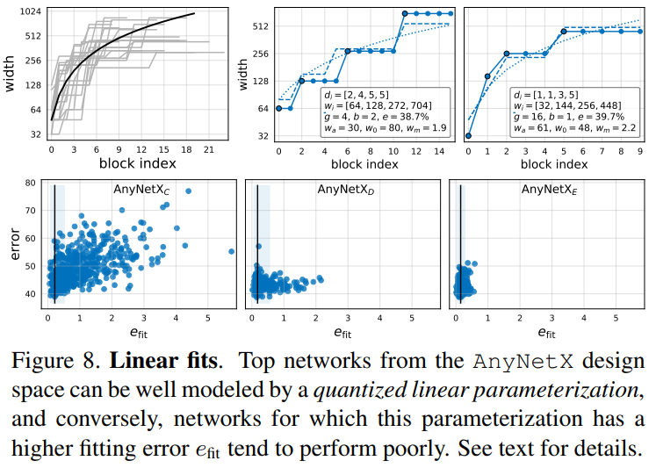



The RegNet Design Space
Now, AnyNetXE is best
Quantization
Float
Hold consistency in the same block

Slide 10
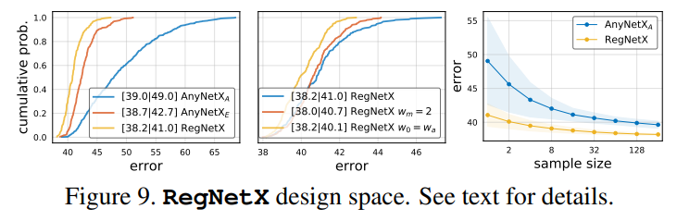
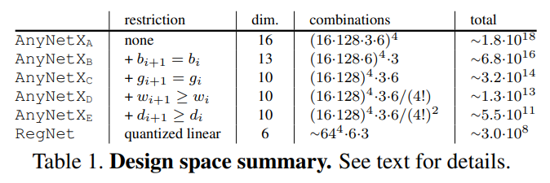
The RegNet Design Space

Slide 11
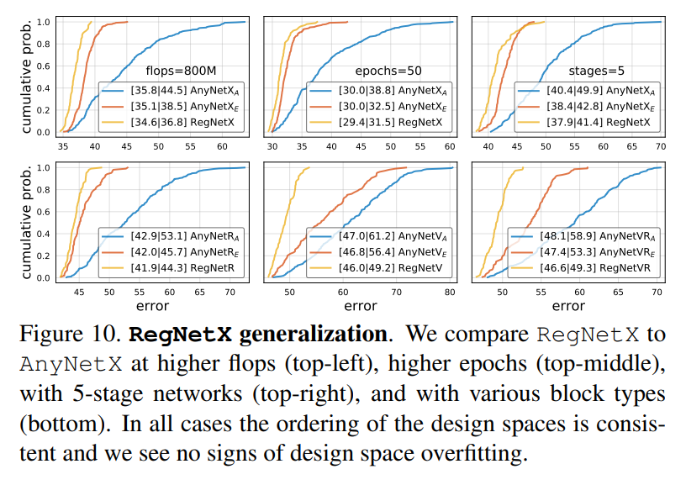
Design Space Generalization

Slide 12
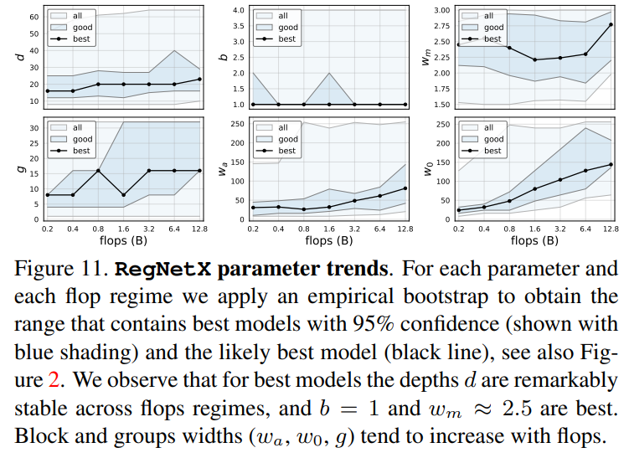
Analyzing the RegNetX Design Space

Slide 13
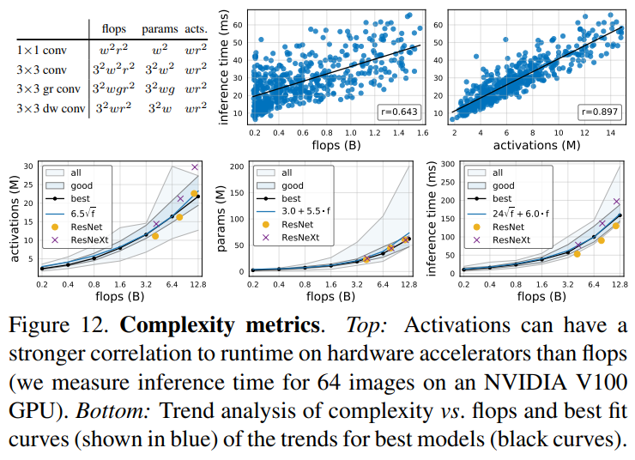
Analyzing the RegNetX Design Space

Slide 14
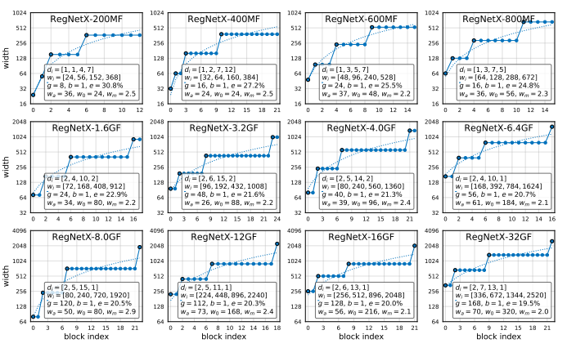
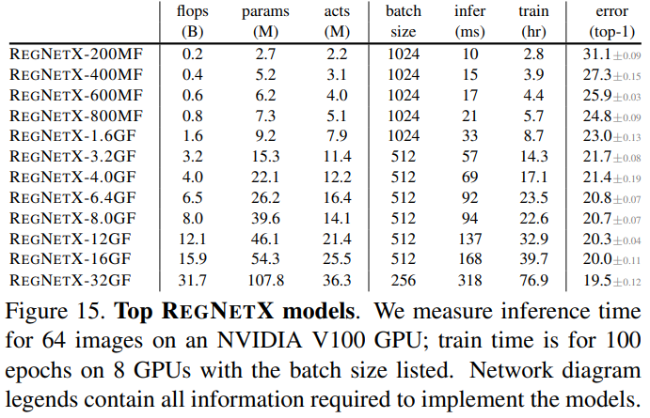
Comparison to Existing Networks

Slide 15
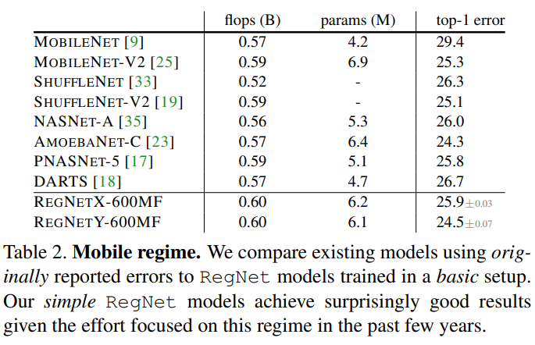
Comparison to Existing Networks

Slide 16
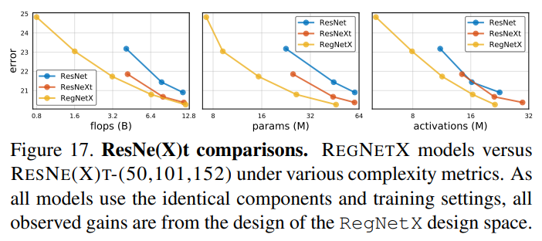
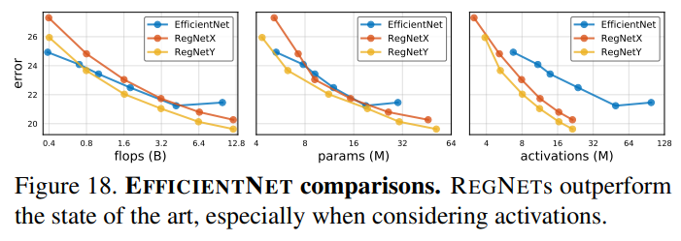
Comparison to Existing Networks

Slide 17
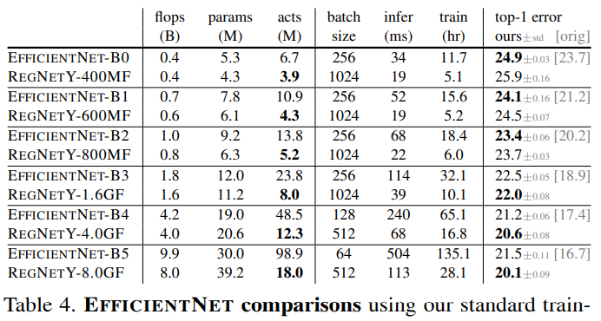
Comparison to Existing Networks

Slide 18
Summary
Depth: ~20 blocks
Bottleneck ratio: 1~2
Activation > flops in inference time
Why 10 epoch (Zhihu)

